Slide 1
Energy map improvement for Seam Carving
第九組
105042015 沈冠妤
105042004 林立雯

Slide 2
Outline
Problem description
System structure
Method
Edge detection
Color Ranking
Combination
Conclusion

Slide 3
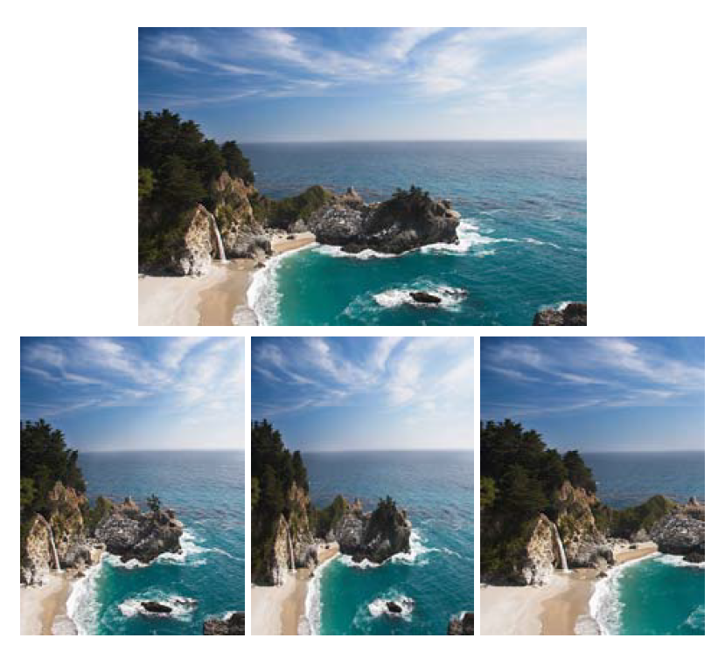
Problem description
Seam carving is a content-aware image resizing method
Problem: Highly depends on energy map
seam carving scaling cropping
source: “Seam carving for content-aware image resizing.”

Slide 4
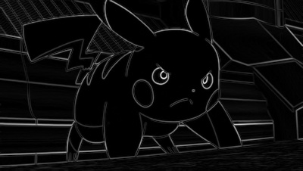
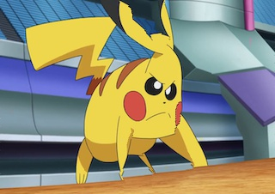
Problem description
Seam carving is a content-aware image resizing method
Problem: Highly depends on energy map
seam carving scaling cropping
source: “Seam carving for content-aware image resizing.”

Slide 5
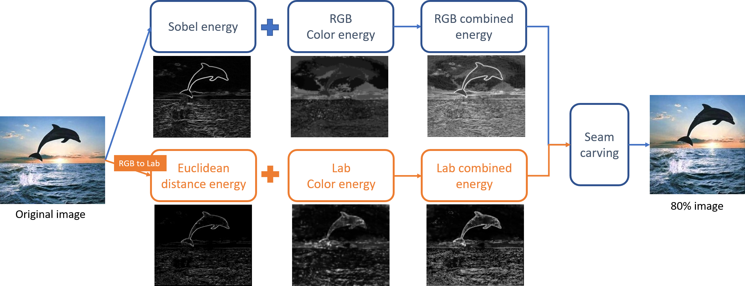
System structure
structure
color

Slide 6
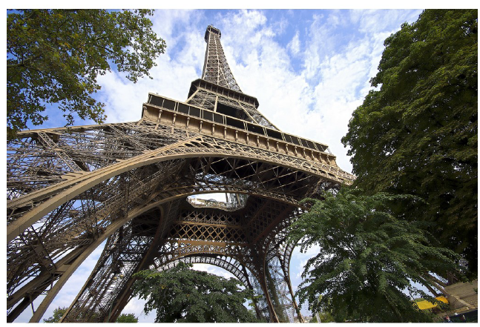
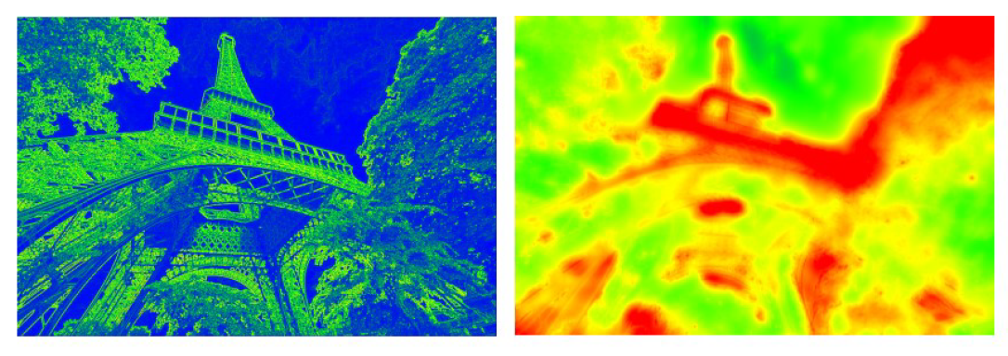
Method
Derive energy map by
Structure detection: structure information
Color ranking: attractiveness of region
gradient map saliency map
source:“Optimized scale-and-stretch for image resizing.”

Slide 7
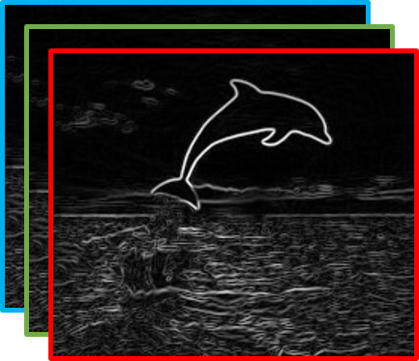
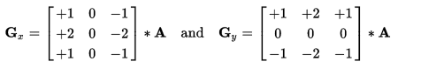
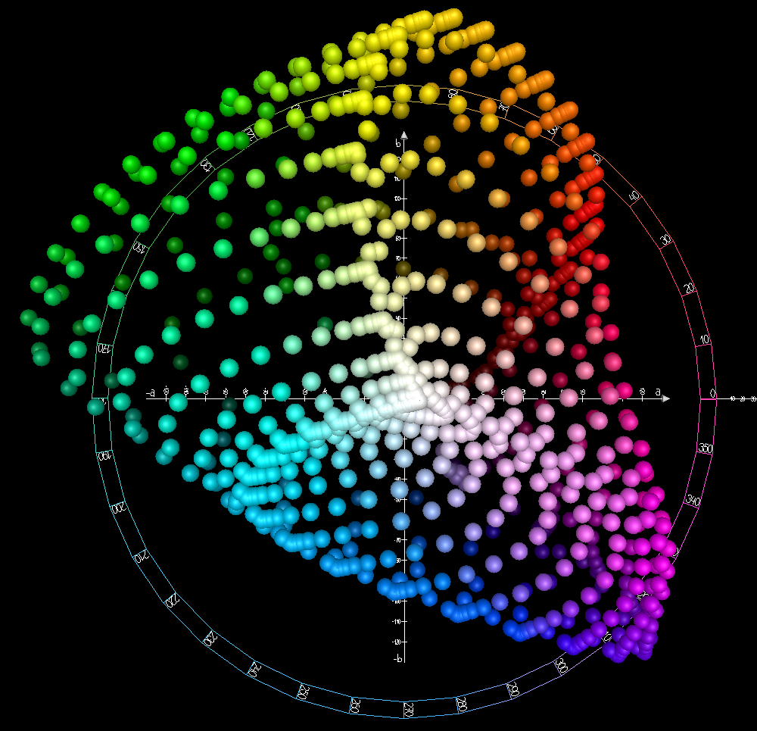
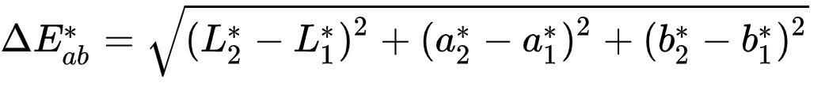
Structure detection
RGB:
Sobel edge detection
CIELAB:
Euclidean distance

Slide 8
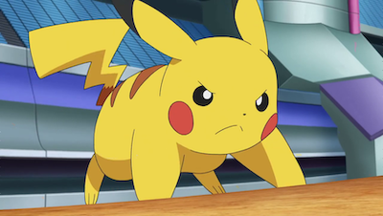
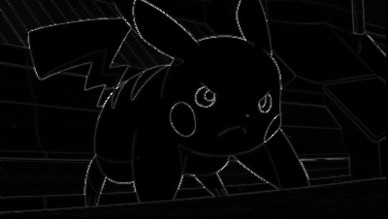
Structure detection
RGB sobel filter
LAB euclidean dist.

Slide 9
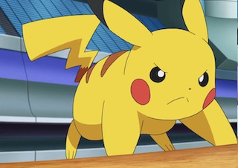
Structure detection
RGB sobel filter
LAB euclidean dist.

Slide 10

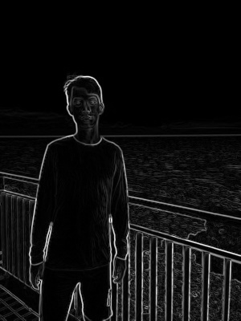
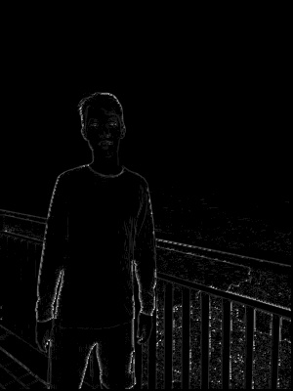
Structure detection
RGB sobel filter
LAB euclidean dist.

Slide 11
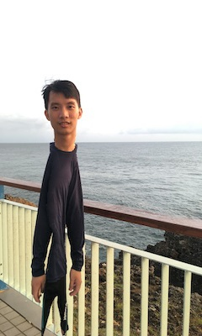
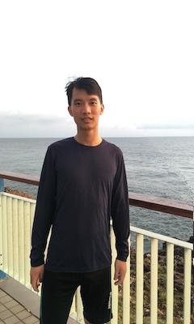
Structure detection
RGB sobel filter
LAB euclidean dist.

Slide 12
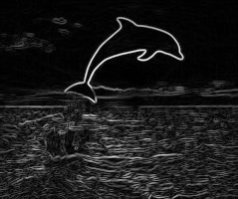
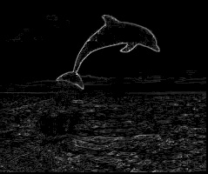
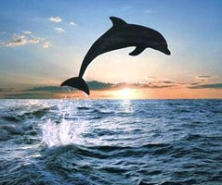
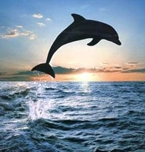
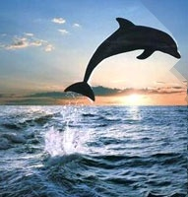
Structure detection: problem
RGB sobel filter
LAB euclidean dist.

Slide 13
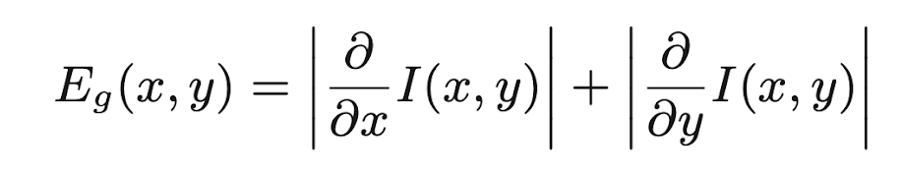
Color Ranking
Color information is ignored in the original equation
Goal:
To give importance to the whole salient region,
rather than just the edges (automatic masking).

Slide 14
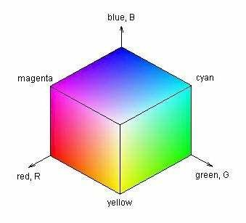
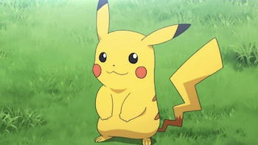
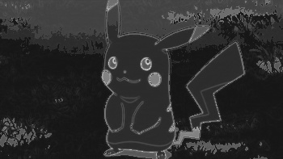
Color Ranking: method
Divide color space into divisions of equal size
Calculate the frequency of each division
Assume divisions with less frequency have higher importance

Slide 15
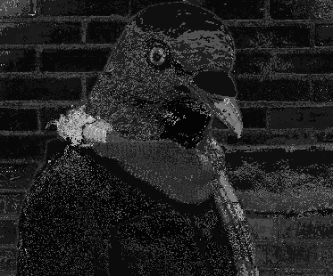
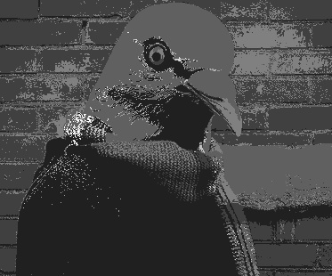
Color Ranking: experiments
Number of color space divisions:
125: color regions tend to be more fragmented.
8: color regions are more clustered.

Slide 16
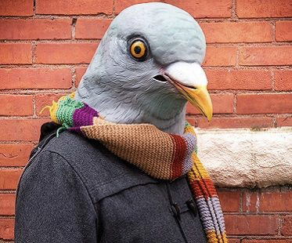
Color Ranking: experiments
Number of color space divisions:
125: color regions tend to be more fragmented.
8: color regions are more clustered.

Slide 17
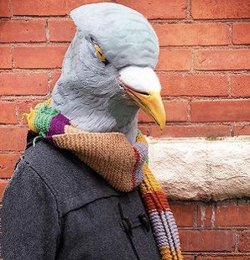
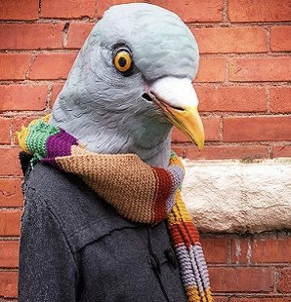
RGB
8 division
RGB
125 division

Slide 18
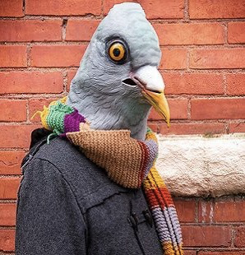

Slide 19
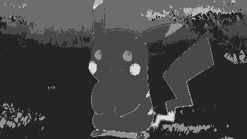
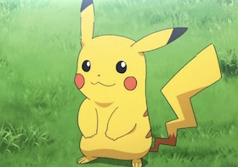
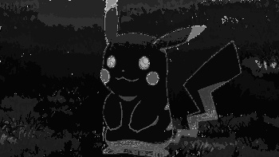
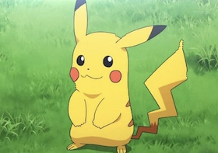
RGB
8 division
RGB
125 division

Slide 20
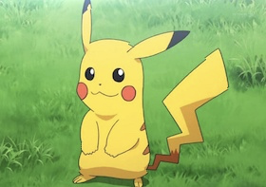

Slide 21
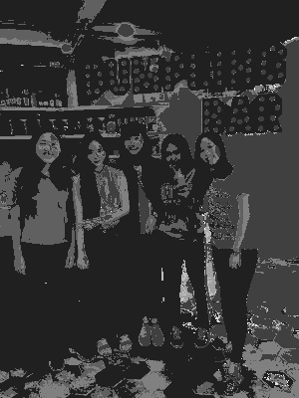
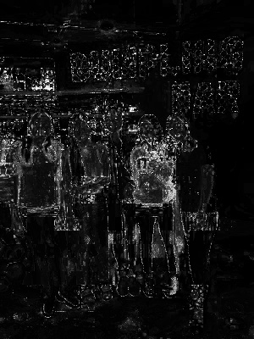
Color Ranking: experiments
Color space:
RGB
CIELAB
RGB
CIELAB

Slide 22
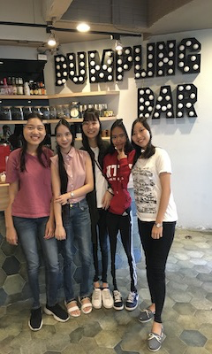
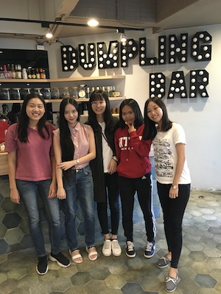
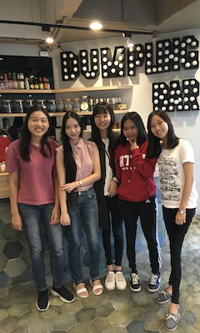
RGB
8 division
CIELAB
8 division

Slide 23
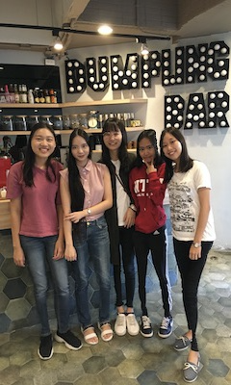
RGB
8 division
CIELAB
8 division

Slide 24

Color Ranking: problem
If salient region has larger proportion of the whole image,
ranking will not work well.

Slide 25
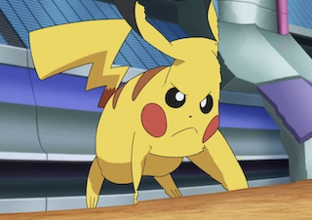
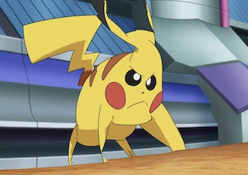
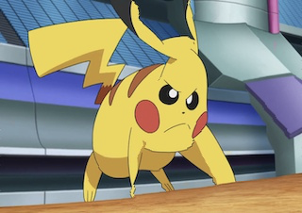
Color Ranking: problem
If salient region has larger proportion of the whole image,
ranking will not work well.

Slide 26
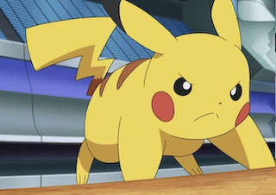

Only structure detection
LAB euclidean distance
RGB sobel filter

Slide 27
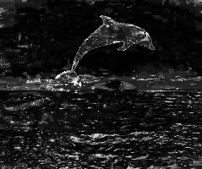
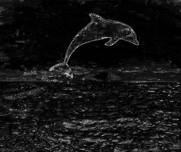
Combination
Combine structure detection map and color ranking map to form the new energy map.

Slide 28
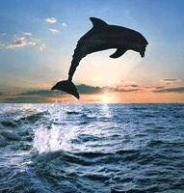

Combination: problem
Combine structure detection map and color ranking map to form the new energy map.

Slide 29


Combination
Gamma transform on structure detection map
gamma = 0.4

Slide 30

Combination
Gamma transform to emphasize structure energy
gamma = 0.4

Slide 31
Conclusion
Contribution:
Utilize color information.
CIELAB color space in energy map.
Automatic masking.
Future work:
Color division based on color histogram of input image, rather than self-defined parameter.

Slide 32
Reference
Avidan, S. and Ariel Shamir. “Seam carving for content-aware image resizing.” SIGGRAPH 2007 (2007).
Rubinstein, Michael et al. “Improved seam carving for video retargeting.” SIGGRAPH 2008 (2008).
Wang, Yu-Shuen et al. “Optimized scale-and-stretch for image resizing.” SIGGRAPH 2008 (2008).
Achanta, R. and S. Süsstrunk. “Saliency detection for content-aware image resizing.” 2009 16th IEEE International Conference on Image Processing (ICIP) (2009): 1005-1008.

